Slide 1
JINIUS SCHEDULER
Function document
https://github.com/pandajiny/jinius-scheduler.git

Slide 2
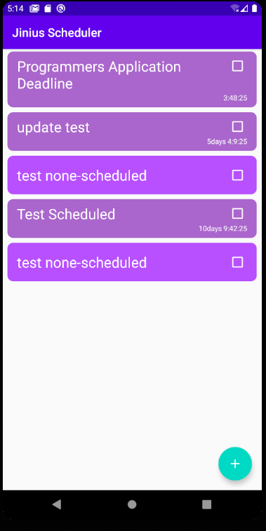
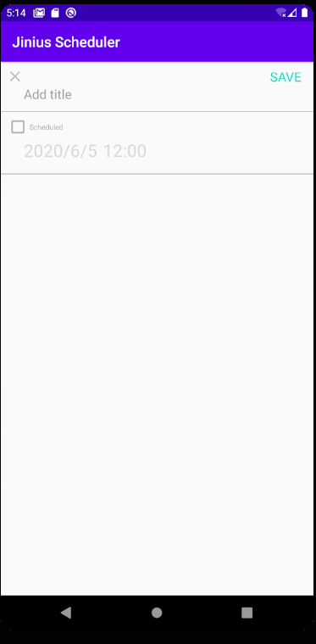
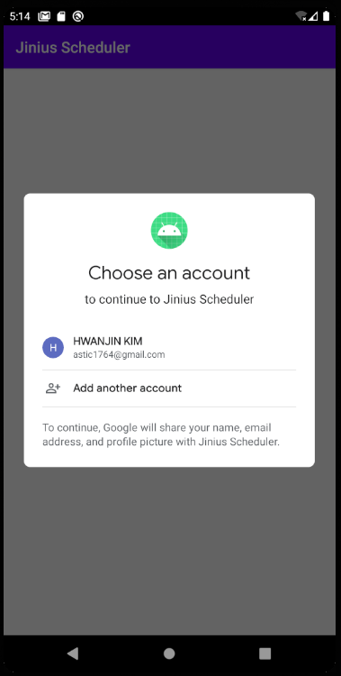
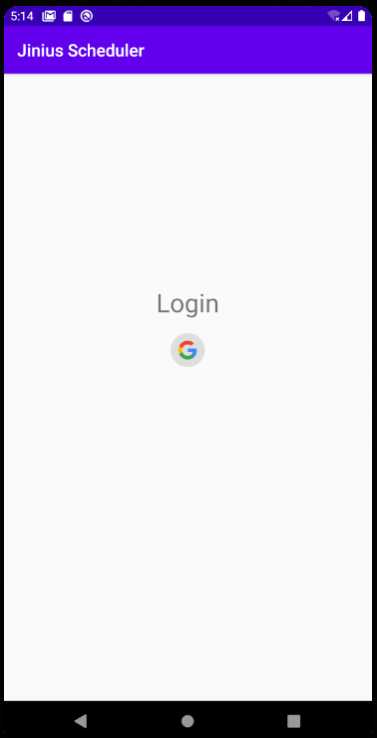
OVERVIEW
Simple Login with google
User Can see each different kind of Events on One Page
Add Todo Activity
Login Activity
Add Schedule

Slide 3
Stack
UI
Authentication
Data storing
Android + Kotlin
Firebase with Google Login
Firebase Realtime database

Slide 4
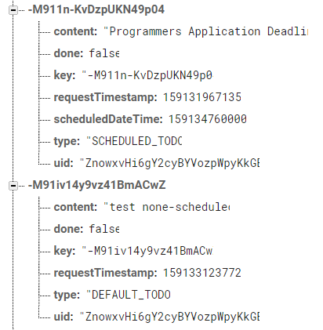
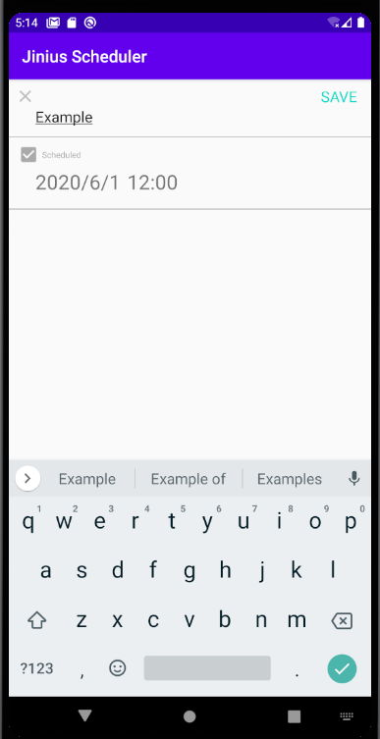
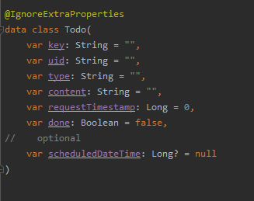
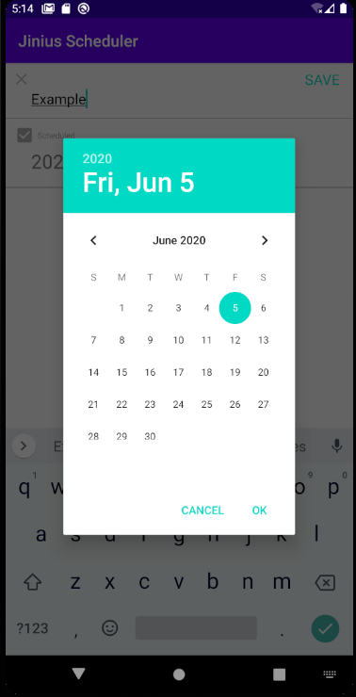
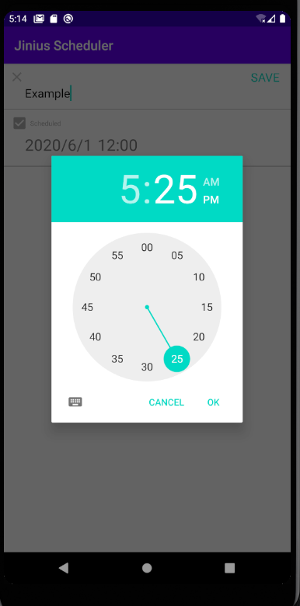
Add Event(Todo)
Class Definition
Content(title) input
User can use ‘scheduled’ option
Type will be changed belong to user selected option
Click Date or Time text, will open time picker dialog fragment
https://github.com/pandajiny/jinius-scheduler/blob/master/android/app/src/main/java/com/example/jiniusscheduler/schedules/todo/AddTodoActivity.kt
Example Add events screen

Slide 5
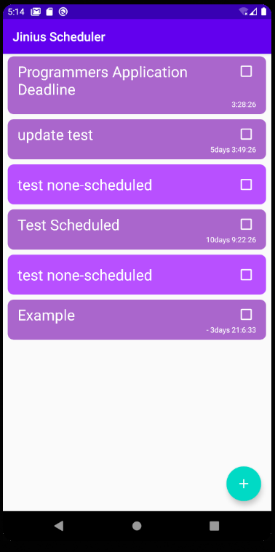
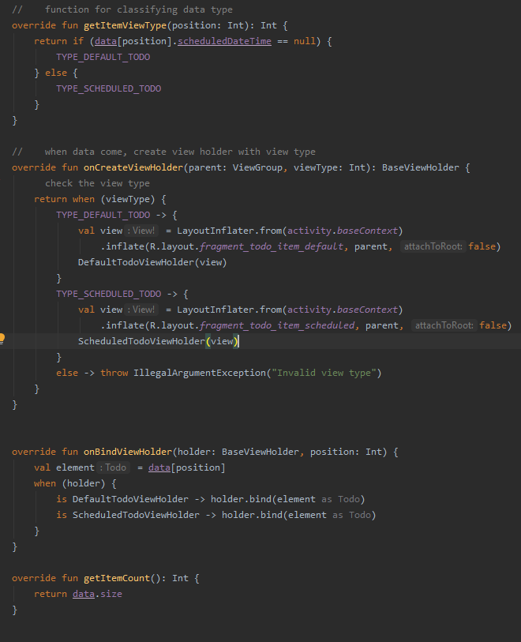

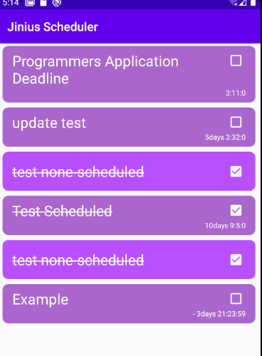
Display Event
Inherit Base View holder
Type checking for each event
-> binding different view holder
Scheduled Event is displaying remain time
User also can check ‘Done’ mark
User can mange event in main screen
https://github.com/pandajiny/jinius-scheduler/blob/master/android/app/src/main/java/com/example/jiniusscheduler/schedules/SchedulesActivity.kt

Slide 6
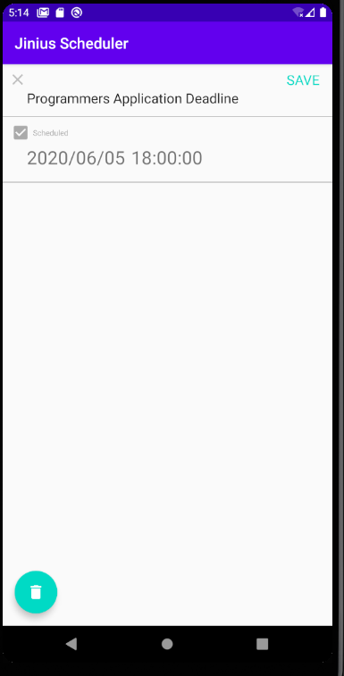
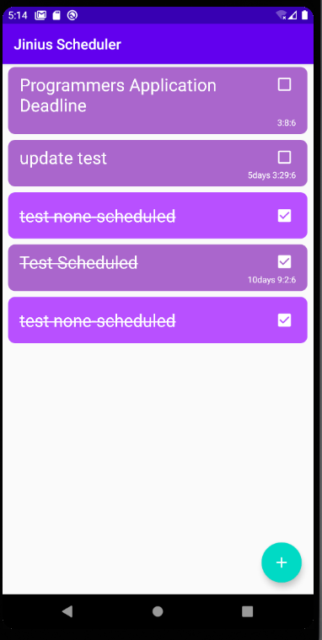
Edit Event(Todo)
Click -> Start Edit Activity
Load Event data and update UI
Immediately deleting event from both of database and Screen
https://github.com/pandajiny/jinius-scheduler/blob/master/android/app/src/main/java/com/example/jiniusscheduler/schedules/todo/EditTodoActivity.kt
Delete button

Slide 7
Next step
Events type
Implement more various kinds of type
Dynamic UI
Scroll and Slide Action
Sharing
Add a friend
Sharing my events with friends.

